Slide 1
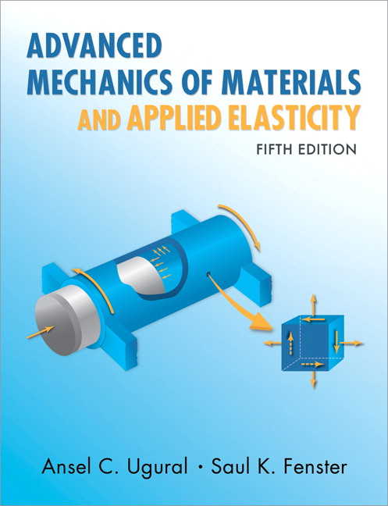
Advanced Mechanics
(Lecture 11)
ANNOUNCE / BUSINESS
HW 5 (due H, 2/20)
Exam 01 grading is further delayed
NEW STUFF
Dynamic loading
Plane stress/strain, Airy’s function

Slide 2

Impact / Dynamic Loading

Slide 3

Notes:
This rigging company is in West Valley City!

Slide 4
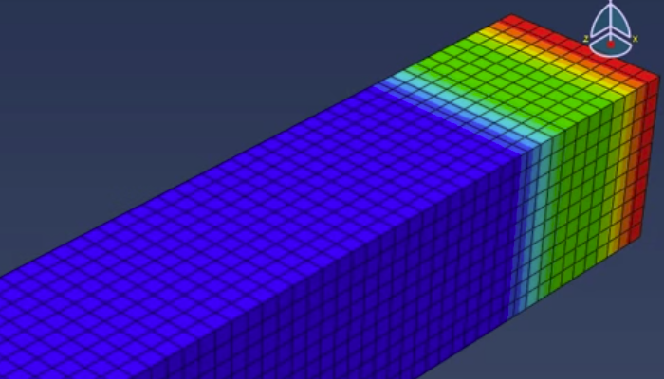
Impact / Dynamic Loading
Forces suddenly applied to parts / structures
Shock or impact loading occur when time of load application is equal to or smaller than largest natural period of vibration of the structure – stress waves are significant

Slide 5
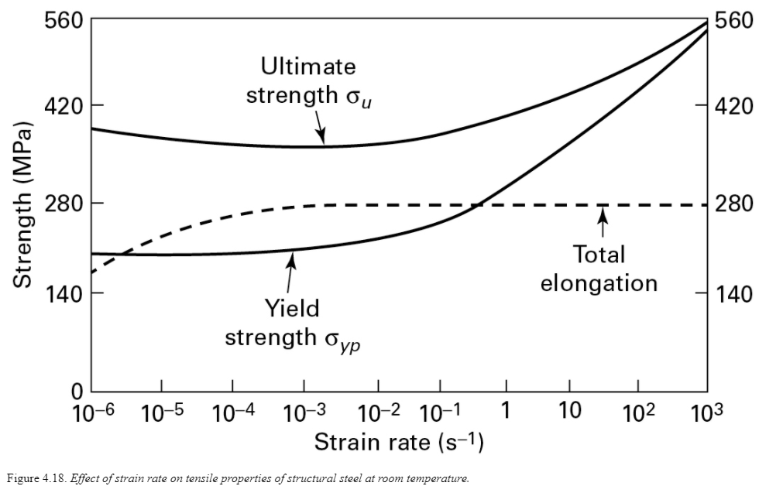
Strain Rate Effects on Materials

Slide 6
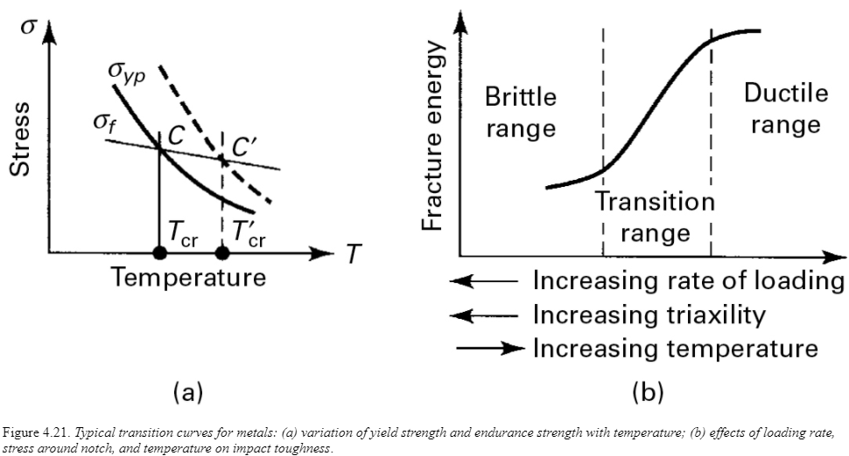

Ductile-Brittle Transition
Increasing temperature results in a decrease of strengths but less reduction of fracture strength, so the material transitions from brittle to ductile failure.
Important? Consider the Titanic (steel used had relatively high ductile-brittle transition temperature)

Slide 7
Ductile-Brittle Transition
Increasing strain rate shifts the yield strength-temperature curve to the right, so the transition, or critical, temperature is higher … thus, brittle fractures occur at higher temperatures in impact, compared to static, tests

Slide 8
Ductile-Brittle Transition
triaxiality

Slide 9
Analysis Approach
Complex, so we focus on approximating maximum deformation and stress, without considering subsequent vibrations
Assumptions in approach
Displacement is proportional to applied force
Inertia of impacted object is ignored
Material behaves elastically – no energy loss!

Slide 10
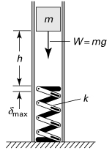





Impact / Dynamic Loading
Consider a mass dropped onto a spring with stiffness $k$
Using Conservation of Energy (?!)
Define impact factor $K$
Consider extreme case $h=0$

Slide 11

Impact / Dynamic Loading
We can derive similar equations for horizontal impacts
Here $δ_{st}$ is the deflection caused by a force $W$ applied statically in the horizontal direction; $v$ is the resulting velocity.

Slide 12
Impact / Dynamic Loading

Slide 13
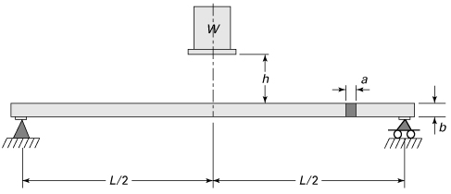
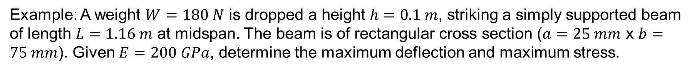
Impact / Dynamic Loading
Example: A weight $W=180 N$ is dropped a height $h=0.1 m$, striking a simply supported beam of length $L=1.16 m$ at midspan. The beam is of rectangular cross section ($a=25 mm$ x $b=75 mm$). Given $E=200 GPa$, determine the maximum deflection and maximum stress.

Slide 15
Theory of Elasticity
Theory of elasticity v. mechanics of materials (aka elementary theory or technical theory)
Mechanics of materials
assumes strain distribution (e.g. plane sections remain plane in bending and torsion)
best suited for relatively slender members
Theory of Elasticity
more exact solutions requiring fewer assumptions
good check for solutions from mechanics of materials and computational methods
Notes:
- Consider cases where any of our fundamental loading modes (axial, tension, bending) is applied to a part that is not slender. Assumptions required for the elementary theory no longer apply. Consideration of local stresses near an applied force cause a similar problem; hence, St. Venant’s theory.

Slide 16
Theory of Elasticity – Solutions
3D: 15 equations and 15 unknowns!
2D: many important problems can be simplified into either plane stress or plane strain

Slide 17
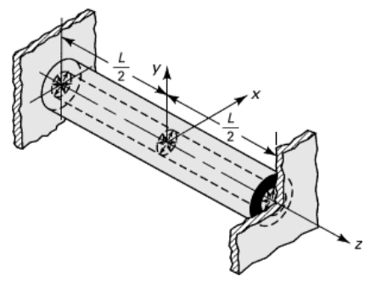
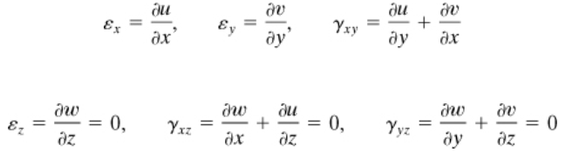
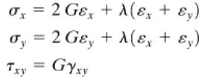

Theory of Elasticity – Plane Strain
Consider cylinder under pressure and constrained in $z$-direction at ends
Strain-displacement
Stress-strain

Slide 18


Theory of Elasticity – Plane Strain
Compatibility
Now substitute stress for strain to get …
(1)

Slide 19
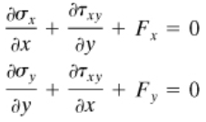



Theory of Elasticity – Plane Strain
Recall equilibrium equations (just 2D)
Differentiate with respect to $x$ and $y$, respectively, and add together to get …
Substitution of this into (1; previous slide) gives the eq’n of compatibility in terms of stress
All solutions to plane strain problems must satisfy this equation

Slide 20
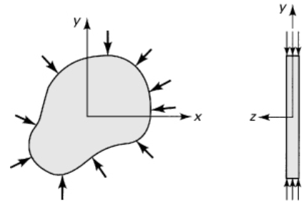

Theory of Elasticity – Plane Stress
A similar approach with plane stress leads to …

Slide 21

Theory of Elasticity
Note the similarity between the equations for plane strain and plane stress
In the absence of body forces, they are the same ($RHS=0$)
For identical geometry and loading conditions, the resulting stress distribution is independent of material properties … important to photoelasticity

Slide 22
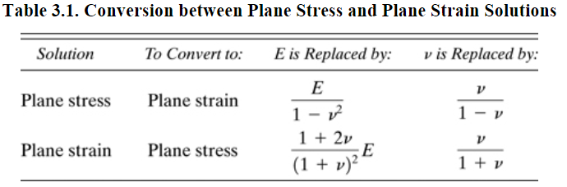
Theory of Elasticity
Because of similarities, we can convert a solution for a plane stress problem into a solution for a plane strain problem (e.g., convert solution for narrow beam to that for a very wide beam), and vice-versa, with the following substitutions …

Slide 23


Theory of Elasticity
The previous shows that any solution to a 2-D elasticity problem, in the absence of body forces, must satisfy the equilibrium equations,
the following derived compatibility expression,
and boundary conditions.

Slide 24





Airy’s Stress Function
Based on the work of Airy, we now define a stress function, $Φ(x,y)$ such that
Substituting these into the compatibility expression on the previous slide,
To solve this biharmonic equation and find a solution, we search for some stress function, $Φ(x,y)$, that satisfies both it and the boundary cond.’s, e.g.

Slide 25
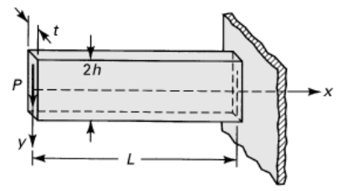


Airy’s Stress Function
Consider Example 3.1 in text … determine the stress distribution in a narrow cantilever beam, neglecting the weight of the beam.
Two other approaches are also shown in the text, but you hopefully get a sense for how elasticity solutions are found.
We won’t need to perform such solutions in this class (take Theory of Elasticity if desired!) … we will just use them, but it is important to understand something about where they come from.

Slide 26
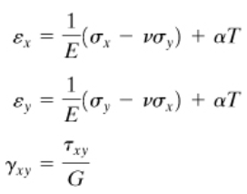

Linear Thermoelasticity
We can also incorporate the influence of temperature ($T$) on deformation … via superposition
This works well as long as the stress distribution and temperature are not coupled ($σ=f\left(e\right)$; $σ≠f(e,T)$)

